Slide 1
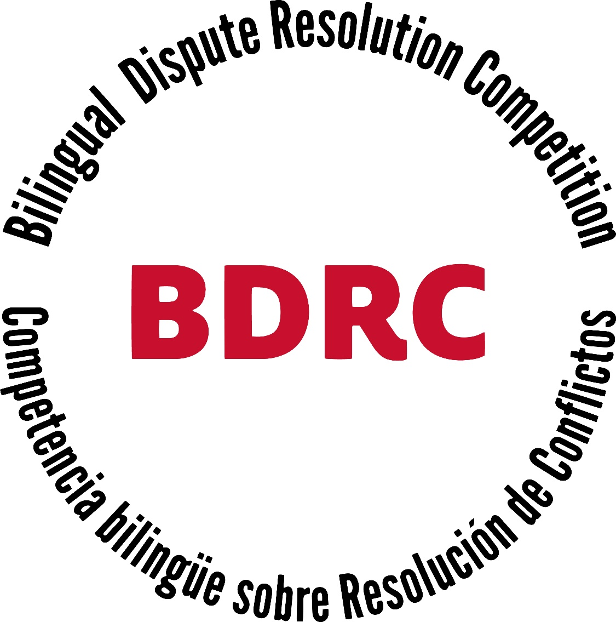

Train The Trainers
Bilingual Dispute Resolution Competition 2021
(updated 2/24/2021)

Slide 2
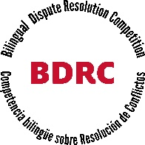
UH Law Center – BDRC Pilot
Alfonso Lopez de la Osa Escribano, Director, Center for U.S. and Mexican Law
Karen Jones, Executive Director, Global and Graduate Programs
James Lawrence, Executive Director, Blakely Advocacy Institute

Slide 3
About the BDRC
Spanish is second most prevalent language in Houston
Spanish is challenging the English-only model in the U.S.
Increasing multi-lingual business and communication
Growing value of English/Spanish Bilingualism

Slide 4
11 Mar.
Teams Finalized
Team member names and contact information submitted to Blakely Advocacy Institute
Coach name(s) and contact information submitted to Blakely Advocacy Institute
12 Mar.
Problem Sets Released
8 Apr.
Online Dispute Resolution: Round 1 (in English)
4:00 – 6:00 PM
9 Apr.
Online Dispute Resolution: Round 2 (in Spanish)
4:00 – 6:00 PM
16 Apr.
Final Round
(1 team member speaks in English and 1 in Spanish for each of the two teams)
4:00 – 6:00 PM
Opening
Reception
5:30 – 7:00 PM
Key Dates
7 Apr.

Slide 5

Competition Outline
Preliminary Elimination Rounds
8 April
4:00 – 6:00 PM
Round 1
English
University of Houston
Team 1
University of Houston
Team 2
University of Houston
Team 3
University of Houston
Team 4
Universidad La Salle
Team 1
Universidad La Salle
Team 2
Universidad Anahuac
Team 1
Universidad Anahuac
Team 2
9 April
4:00 – 6:00 PM
Round 2
Spanish
University of Houston
Team 1
University of Houston
Team 2
University of Houston
Team 3
University of Houston
Team 4
Universidad Anahuac
Team 1
Universidad Anahuac
Team 2
Universidad La Salle
Team 1
Universidad La Salle
Team 2

Slide 6
Competition Outline
Championship Round
16 April
4:00 – 6:00 PM
University of Houston
Team Member 1
English Only
Universidad Anahuac/LaSalle
Team Member 1
English Only
University of Houston
Team Member 2
Spanish Only
Universidad Anahuac/LaSalle
Team Member 2
Spanish Only

Slide 7
BDRC: Why this competition?

Slide 8
Hispanic lawyers : more & more working opportunities in the U.S. and Mexico.
Greater demand from law firms in the U.S.
Professional advantage of bilingual, binational, bicultural lawyers
Few challenges though, but you can cope with them !

Slide 9
Knowledge and understanding of respective legal systems: e.g. the Mexican and the U.S.
  Roman or Napoleonic codification
  Anglo-Saxon system
Passing the exam of the corresponding bar
Special capacity of binational lawyers to adapt to different legal cultures: they normally have a binational, bicultural or transnational training
They will know what to do to succeed in the transaction, to get the deal done

Slide 10
Binational lawyer or international lawyer?
Binational lawyer
a term increasingly used in the United States, comparative law has become an unparalleled tool,
  when knowing the law of each country,
  but also when integrating the comparison and anticipating obstacles or pitfalls
To this end, the education and training of binational lawyers should seek to be as similar as possible in both systems of law.
Knowledge of languages
Controversy about a Binational lawyers
Detractors: doesn’t integrate the relationship that may exist between different countries, but deals with two nations juxtaposed or parallel
Supporters:
  it represents an even greater degree of integration
  binational lawyer can represent the paradigm of the person who has assumed and integrated two legal cultures and is equally competent in both

Slide 11
The skills and capacities of a binational lawyer:
Excellent student with the intellectual interest of knowing how other legal systems work;
Good communicator, knows how to move and adapt quickly to the environment, (work meetings, with clients, or in Courts);
  Excellent communication skills: expresses arguments in orderly and structured manner, as a person used to work in different legal and cultural environments (comprehension)
Follows continuing education trainings in the countries they are interested in (Bars, Professional associations), on national topics and comparative law topics
Complies with the accreditation or equivalences systems by recognized authorities: JD, LLM, PhD. etc.
Becomes an expert in both countries at the same time, or has been an expert in one specific field and develops an expertise in the other country’s same field afterwards.

Slide 12
coaching

Slide 13
Coaching:
Team Selection
Hand-Selected by the Coach
Students Self-Select
Competition

Slide 14
Coaching:
Problem Analysis
Understanding the Factual Scenario
Rank-Ordered List of Client’s Interests (Essential, Would Like To Have, Would Be Good To Have)
Best Alternative To A Negotiated Agreement (BATNA)

Slide 15
Coaching:
Practicing With the Team
Discuss and Practice Negotiation Strategy
Practice Against Other Students
Practice Against The Coach
Simulate Actual Competition Format

Slide 16
Coaching:
Tips
Make Sure To Be Encouraging
Do Not Do The Work For Them
Analyze And Critique Their Performance
Remember: Advocacy Is An Art
Make It Fun!

Slide 17
Judging

Slide 18
BDRC judge
Responsible for judging the rounds of the competition

Slide 19
Judging: Preparation
Online - Access
Competition Rules, Problems, Confidential Information
Score Sheet

Slide 20
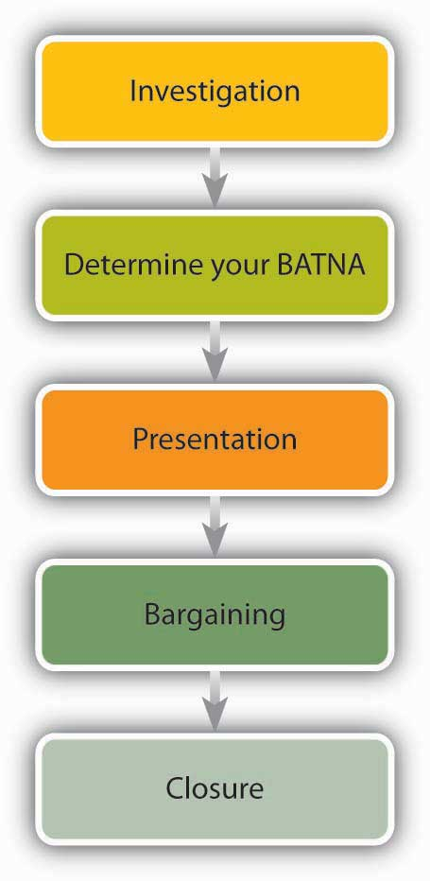
Negotiation Process
Are the Lawyers using good negotiation skills?
Are they moving through the negotiation process effectively?
Are they asking probing questions to facilitate resolution and settlement of identified issues?
Are they working well with their co-counsel and collaborating effectively with the opposing team?

Slide 21
Score Sheet
1. Preparation and Working Atmosphere
The lawyers established the beginning of an effective professional relationship and working atmosphere with opposing counsel. The lawyers were prepared for the proceeding and appeared confident and comfortable.
1 2 3 4 5 6 7 8 9 10
(Poor) (Fair) (Average) (Good) (Excellent)

Slide 22
Score Sheet
2. Case Analysis
The lawyers analyzed the case with creativity from both legal and non-legal perspectives
1 2 3 4 5 6 7 8 9 10
(Poor) (Fair) (Average) (Good) (Excellent)

Slide 23
Score Sheet
3. Presentation of the Case
The lawyers presented the main points of the case concisely and effectively.
1 2 3 4 5 6 7 8 9 10
(Poor) (Fair) (Average) (Good) (Excellent)

Slide 24
Score Sheet
4. Information Gathering
The lawyers were successful in exploring the other side’s interests through asking questions and probing interests.
1 2 3 4 5 6 7 8 9 10
(Poor) (Fair) (Average) (Good) (Excellent)

Slide 25
Score Sheet
5. Negotiation Process
The lawyers were successful in exploring options, representing their client’s interests, and using flexibility to come to a deal.
1 2 3 4 5 6 7 8 9 10
(Poor) (Fair) (Average) (Good) (Excellent)

Slide 26
Score Sheet
6. Team Work
The lawyers demonstrated the ability to work together, share responsibility, and communicate with each other effectively.
1 2 3 4 5 6 7 8 9 10
(Poor) (Fair) (Average) (Good) (Excellent)

Slide 27
Score Sheet
7. Negotiating Ethics
The lawyers demonstrated ethical behavior during the negotiation.
1 2 3 4 5 6 7 8 9 10
(Poor) (Fair) (Average) (Good) (Excellent)

Slide 28
Score Sheet
8. Professionalism
The lawyers demonstrated professionalism toward each other and toward their opposing counsels.
1 2 3 4 5
(Average) (Good) (Excellent)

Slide 29
THANK YOU!!

